Slide 1
Introduction to Java
Università di Modena e Reggio Emilia
Prof. Nicola Bicocchi (nicola.bicocchi@unimore.it)

Slide 2
Java Timeline
1991: SUN develops a programming language for cable TV set-top boxes
1996: Java 1
1996: Netscape supports Java. Popularity grows
1998: Java 2 (libraries)
2005: Java 5 (major enhancements)
2014: Java 8
https://en.wikipedia.org/wiki/Java_version_history

Slide 3
Java Features
Platform independence (portability)
Write once, run everywhere
Translated to intermediate language (bytecode)
Interpreted (JIT https://en.wikipedia.org/wiki/Just-in-time_compilation)
Run time loading and linking
Automatic garbage collection
Robust language, i.e. less error prone
Strong type model and no pointers
Exceptions as a pervasive mechanism to
Lots of standard utilities included
Shares many syntax elements w/ C++
Learning curve is less steep for C/C++ Programmers
Pure OO language

Slide 4
Java Programs
Application
It’s a common program, similar to C/C++
Runs through the Java interpreter (Java) of the installed Java Virtual Machine (JVM)
Servlet (web server)
Java program that extends the capabilities of a Web server
Java counterpart to other dynamic Web content technologies such as PHP and ASP.NET
Applet (deprecated)
Java code dynamically downloaded
Execution is limited by “sandbox”

Slide 5
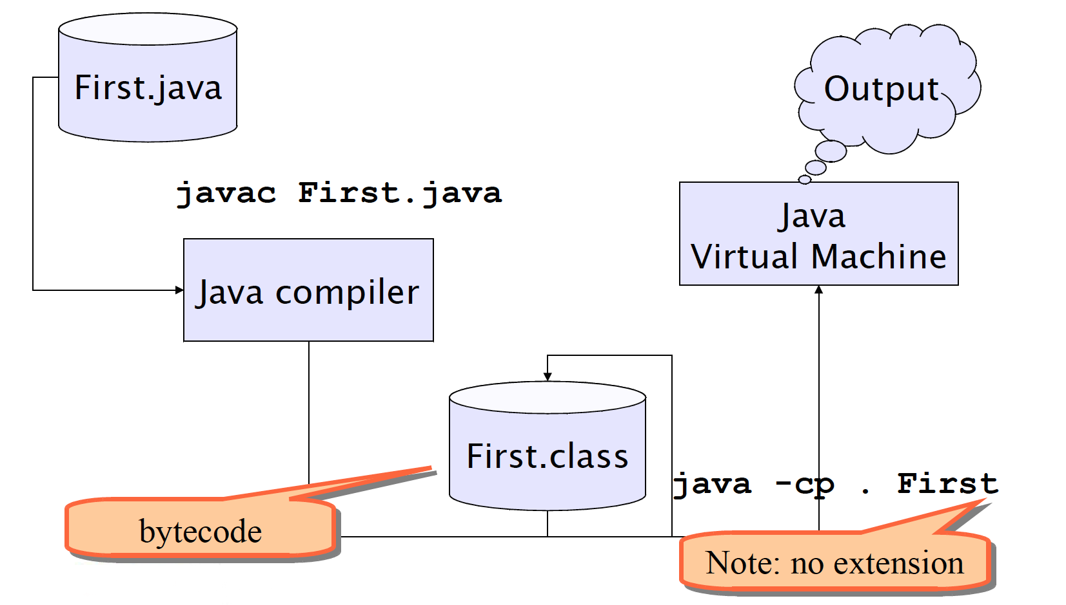
Building and running

Slide 6
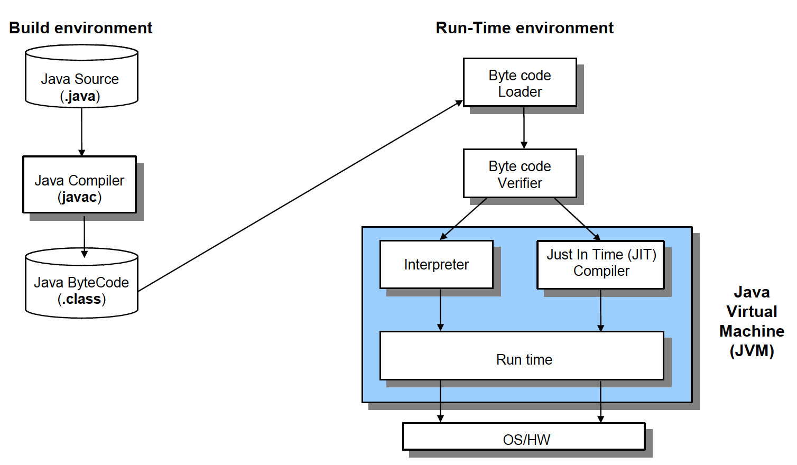
Building and running

Slide 7
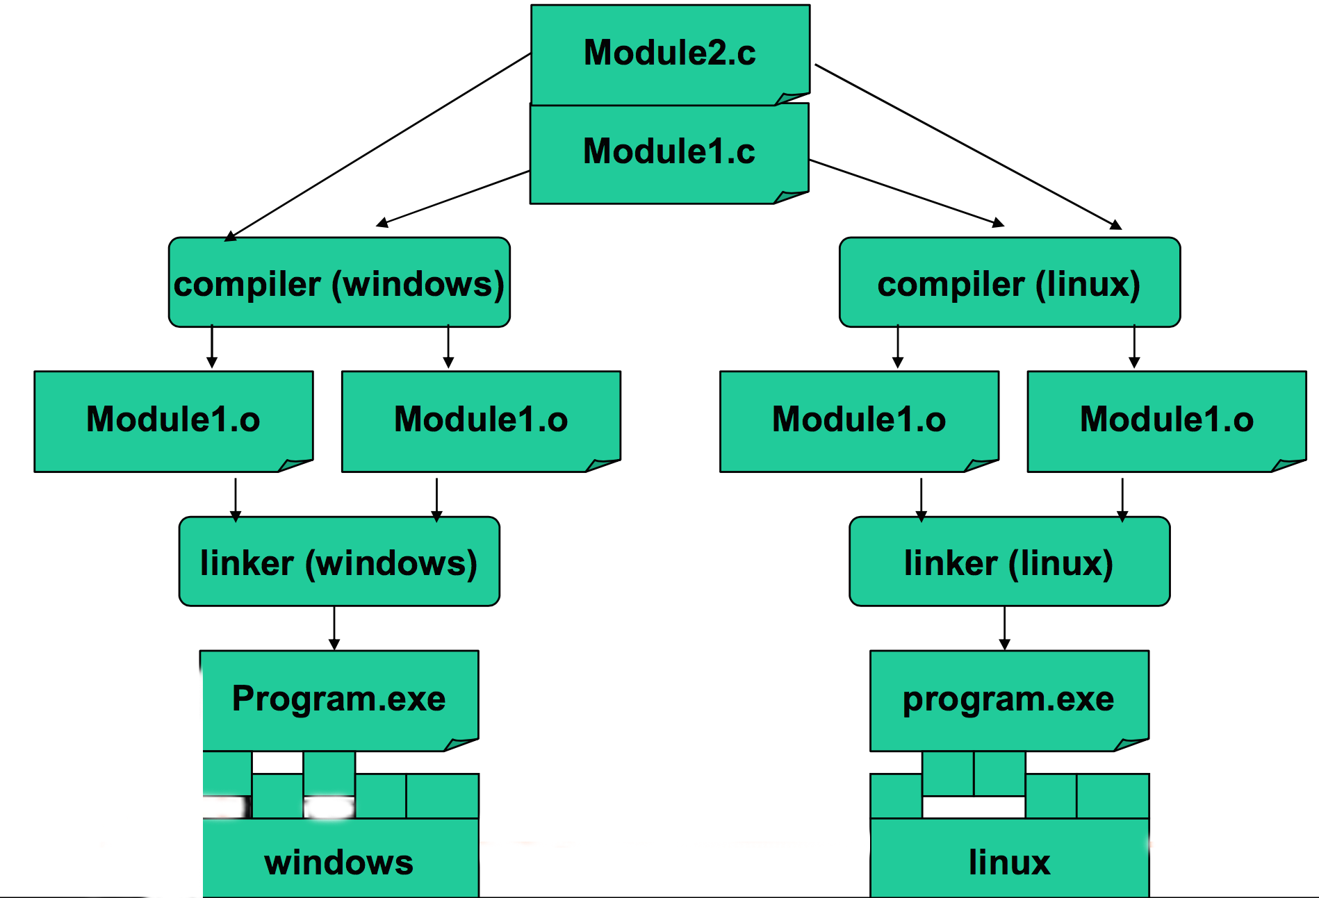
C (Compiled)

Slide 8
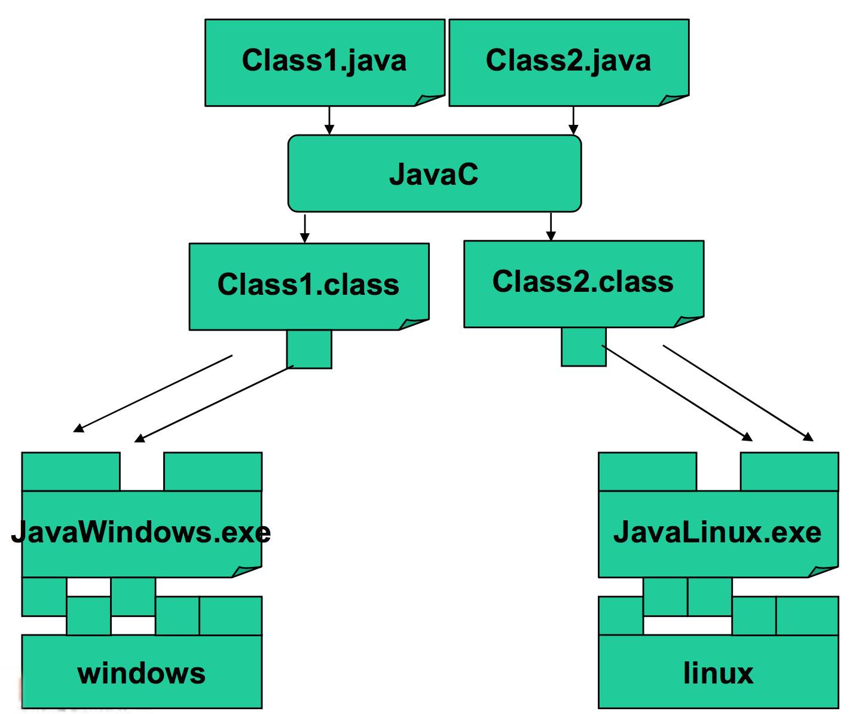
Java (Interpreted)

Slide 9
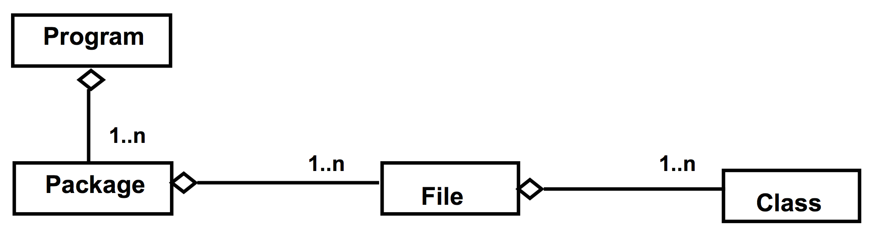
Program, files and classes
A program is made of one or more packages, containing one or more files
A file contains one public class and, optionally, multiple private classes. The file name must be equal to the public class name.

Slide 10
public static void main(String[] args)
In Java there are no functions, but only methods within classes
The execution of a Java program starts from a special method:
public static void main(String[] args) {
…
}

Slide 11
Basic concepts

Slide 12
Comments
C-style comments (multi-lines)
/* this comment is so long
that it needs two lines */
Comments on a single line
// comment on one line

Slide 13
Code blocks and Scope
Java code blocks are the same as in C language
Each block is enclosed by braces { } and starts a new scope for the variables
Variables can be declared both at the beginning and in the middle of block code
for (int i=0; i<10; i++){
int x = 12; ... int y;
...
}

Slide 14
Control statements
Same as C
if-else
switch
while
do-while
for
break
continue

Slide 15
Passing Parameters
Parameters are always passed by value
...they can be primitive types or object references
Note well: only the object reference is copied not the value of the object

Slide 16
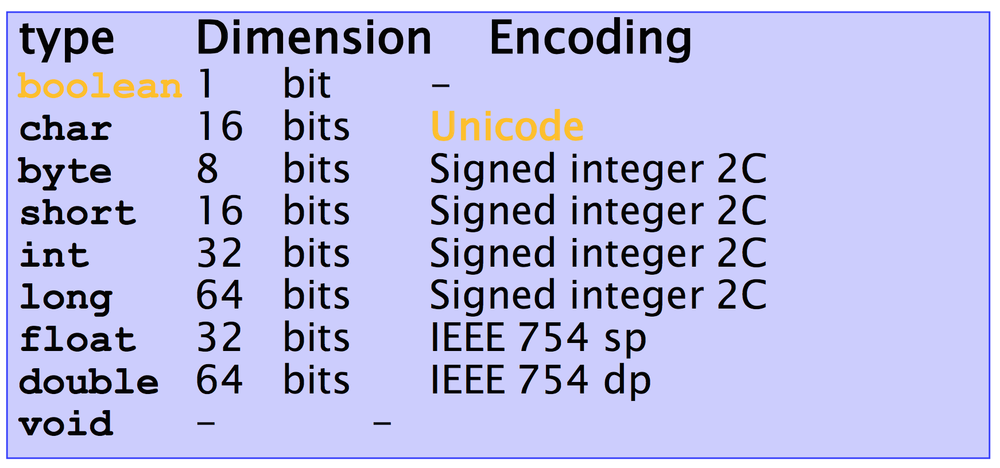
Primitive types
Unique dimension and encoding
Platform-independent representation

Slide 17
Constants
The final modifier
final float PI = 3.14;
PI = 16.0; // ERROR, no changes
final int SIZE; // ERROR, init missing
Use uppercases (coding conventions)

Slide 18
Constants
Constants of type int, float, char, strings follow C syntax
123 256789L 0xff34 123.75 0.12375e+3
“a” ‟%” ‟\n” “prova” “prova\n”
Boolean constants (do not exist in C) are
true, false

Slide 19
Operators (integer and floating-point)
Operators follow C syntax:
arithmetical + - * / %
relational == != > < >= <=
bitwise (int) & ! >> << ~
Assignment = += -= *= /= %= &= |= ^=
Increment ++ --
Chars are considered like integers (e.g. switch)

Slide 20
Logical operators
Logical operators follows C syntax:
&& || ! ^
Note well: Logical operators work ONLY on booleans. Type int is NOT considered a boolean value like in C

Slide 21
Coding Conventions
class ClassName {
const double PI = 3.14;
private int attributeName;
public void methodName {
int var;
if ( var==0 ) {
/* this is comment*/
}
}
}

Slide 22
Strings

Slide 23
String
No primitive type to represent string
􏰀C
char s[] = “literal”
Equivalence between string and char arrays
􏰀Java
char[] != String
java.lang.String (see Java API)

Slide 24
String
String: an object storing a sequence of text characters.
Creating a string:
String name = "text";
String name = expression;
Examples:
String name = "Marty Stepp";
int x = 3;
int y = 5;
String point = "(" + x + ", " + y + ")";

Slide 25
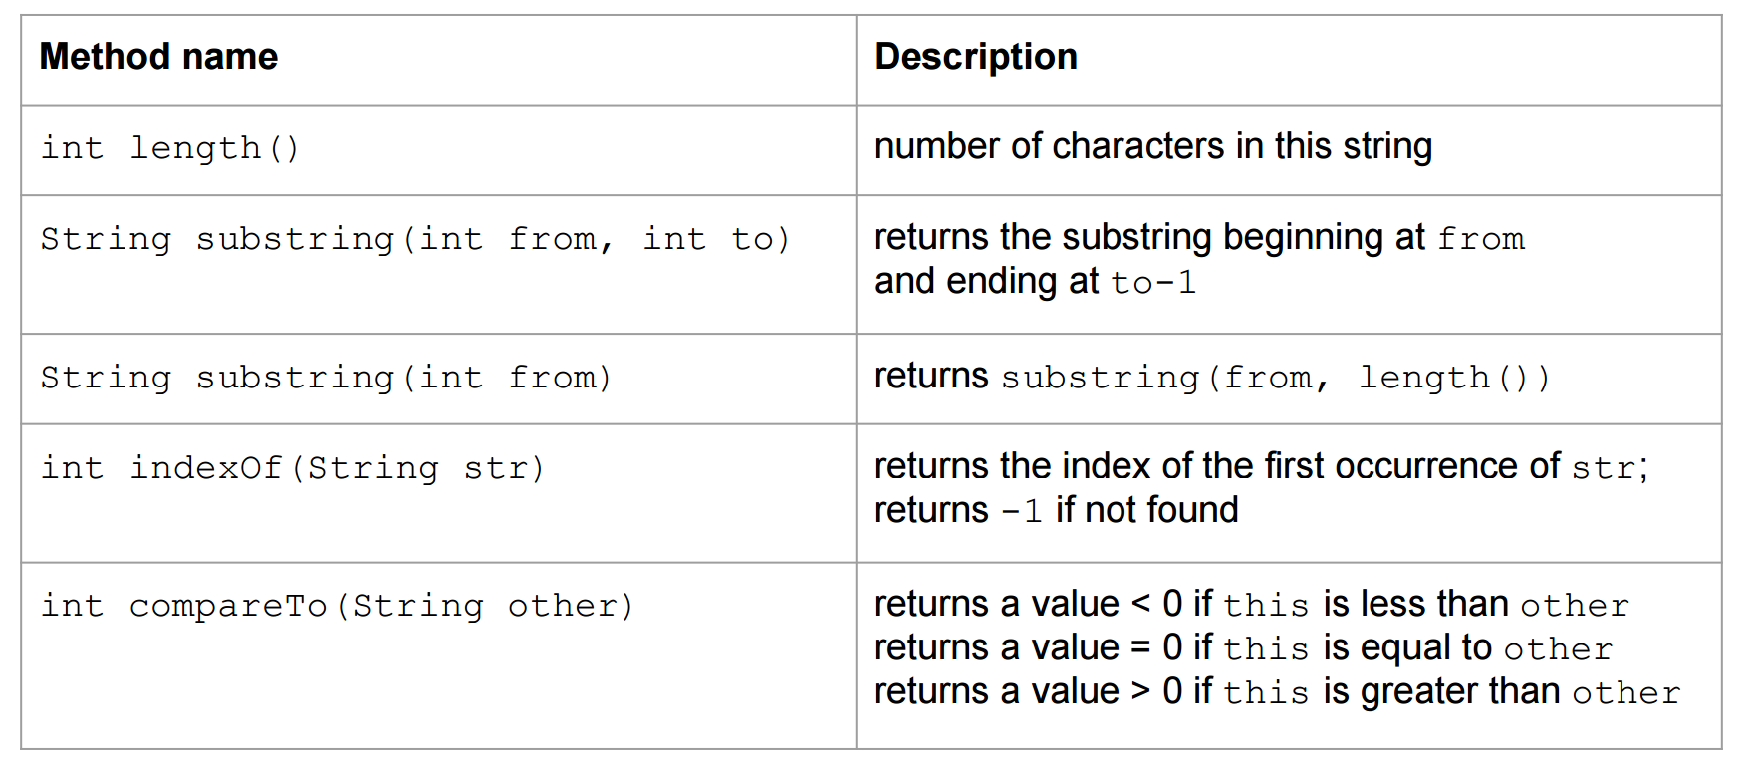
String

Slide 26
The equals method
Objects (not only Strings) are compared using a method named equals.
String s1,s2;
if (s1 == s2) {
System.out.println(”s1 and s2 point to the same String object");
}
if (s1.equals(s2)) {
System.out.println("The strings are equal!");
}

Slide 27
Operator +
It is used to concatenate 2 strings
“This string” + ” is made by two strings”
􏰀Works also with other types (automatically converted to string)
System.out.println(”pi = ” + 3.14); System.out.println(”x = ” + x);

Slide 28
StringBuffer
Fast way for concatenating Strings.
A thread-safe, mutable sequence of characters. A string buffer is like a String, but can be modified. At any point in time it contains some particular sequence of characters, but the length and content of the sequence can be changed through certain method calls. (insert(), append(), delete(), reverse(), toString(),…)

Slide 29
StringBuffer
// simple string concatenation
String str = new String ("Stanford ");
str += "Lost!!";
// stringbuffer string concatenation
// each concatenation does not allocate new memory => faster
StringBuffer str = new StringBuffer ("Stanford ");
str.append("Lost!!");

Slide 30
Array

Slide 31
Array
􏰀An array is an ordered sequence of variables of the same type which are accessed through an index
􏰀Can contain both primitive types or object references (but no object values)
􏰀Array dimension can be defined at run-time, during object creation (cannot change afterwards)

Slide 32
Array declaration
􏰀An array reference can be declared with one of these equivalent syntaxes
int[] v, int v[]
In Java an array is an Object and it is stored in the heap
􏰀 Array declaration allocates memory space for a reference, whose default value is null

Slide 33
Array creation
Using the new operator
int[] v = new int[256];
Using static initialization, filling the array with values
int[] v = {2,3,5,7,11,13}

Slide 34
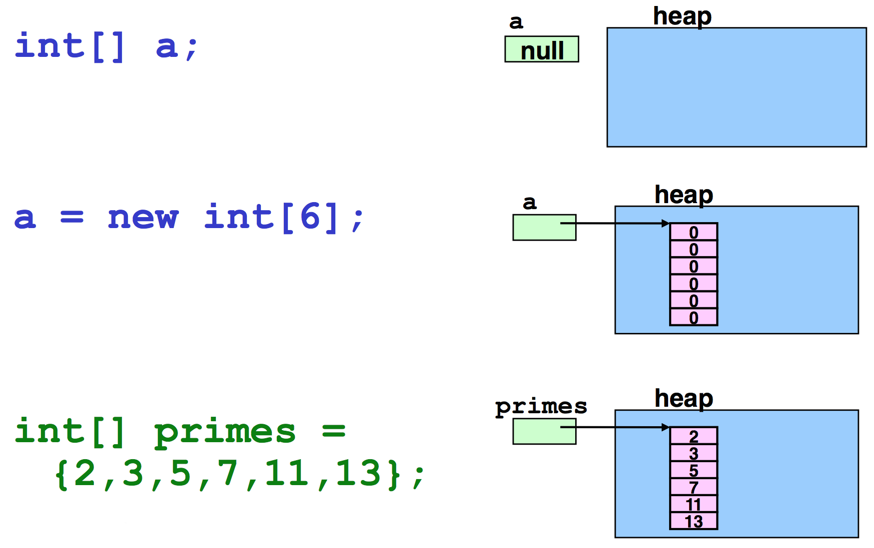
Example – Primitive types

Slide 35
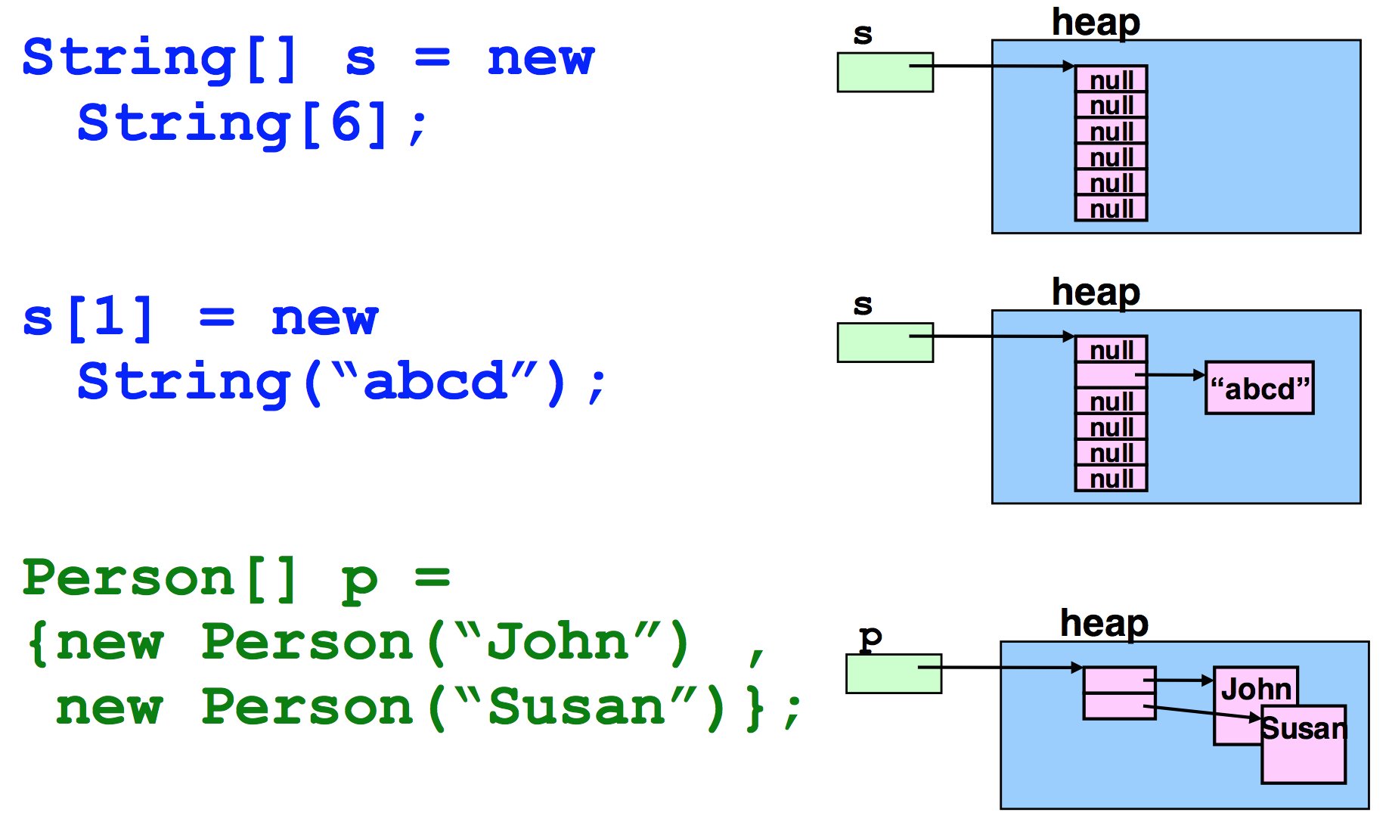
Example – Object reference

Slide 36
Operations on arrays
Elements are selected with brackets [ ] (C-like)
But Java makes bounds checking
􏰀Array length (number of elements) is given by attribute length
for (int i=0; i < a.length; i++) a[i] = i;

Slide 37
Operations on arrays
􏰀An array reference is not a pointer to the first element of the array
􏰀It is a pointer to the array object
Arithmetic on pointers does not exist in Java

Slide 38
Operations on arrays
New loop construct: for( Type var : set_expression )
Notation very compact set_expression can be either
an array
a class implementing Iterable
The compiler can generate automatically loop with correct indexes
less error prone

Slide 39
For each
for(String arg: args){
System.out.println(arg);
//...
}
is equivalent to
for(int i=0; i<args.length;++i){
System.out.println(args[i]); //...
}

Slide 40
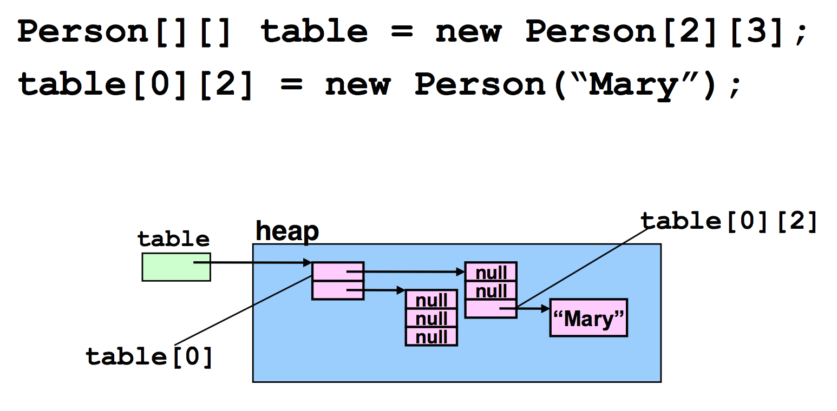
Multidimensional array
Implemented as array of arrays

Slide 41
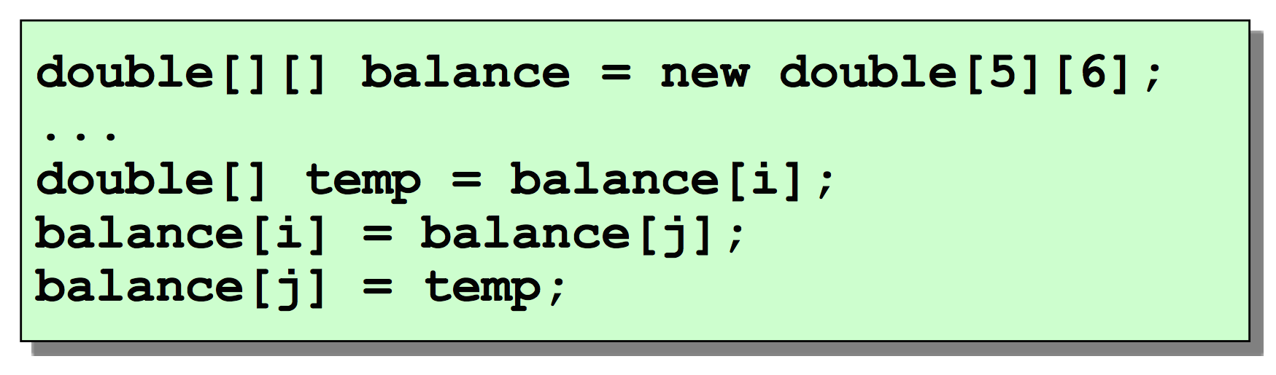
Rows and columns
As rows are not stored in adjacent positions in memory they can be easily exchanged

Slide 42
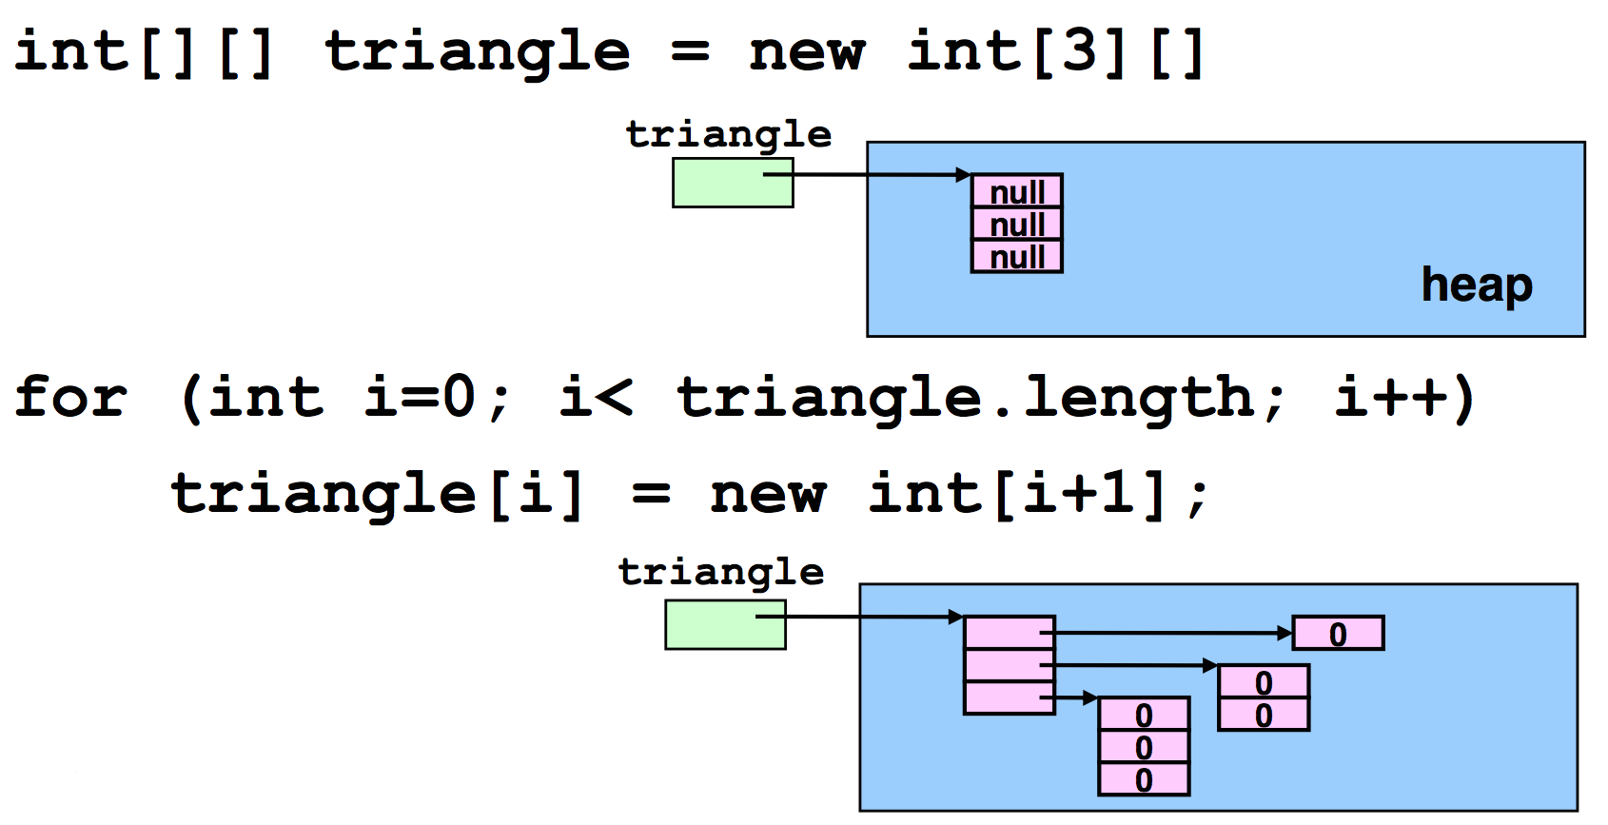
Rows with different length
􏰀A matrix (bidimensional array) is indeed an array of arrays

Slide 43
Classes

Slide 44
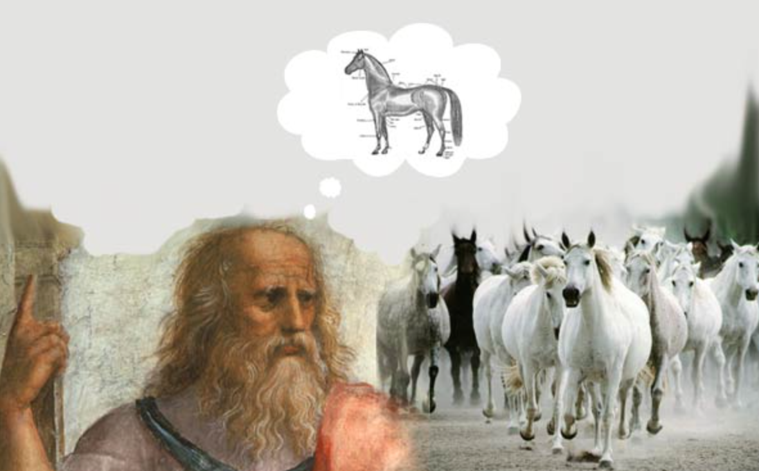
Class
Descriptor of a class of objects (Platonic idea)

Slide 45
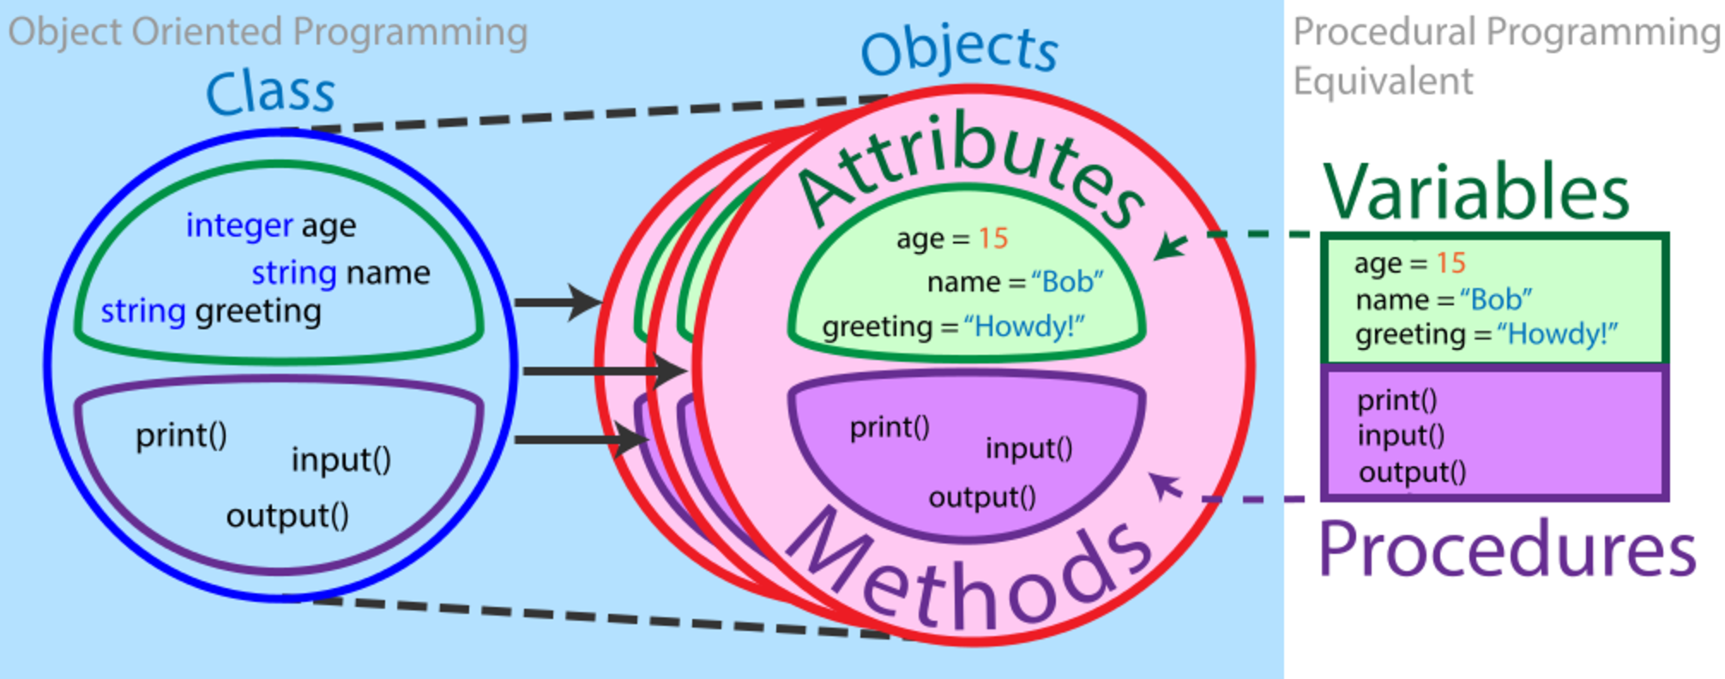
Class

Slide 46
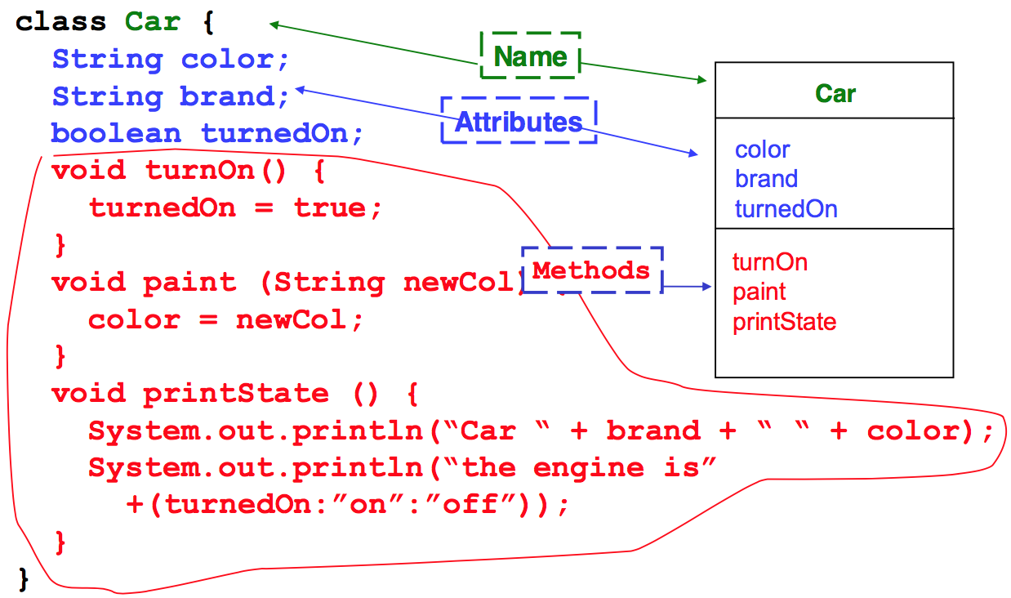
Definition

Slide 47
Information hiding
public class Car {
public String color;
public void setColor(String c) { color = c; }
public static void main(String[] args) {
Car c = new Car();
c.color = “red”; /* OK, Unsafe! */
}
}

Slide 48
Information hiding
public class Car {
private String color;
public void setColor(String c) { color = c; }
public static void main(String[] args) {
Car c = new Car();
c.color = “red”; /* Compiler error*/
c.setColor(“red”); /* OK, Safe! */
}
}

Slide 49
Method Overloading
􏰀Method may have parameters
In a Class there may be different methods with the same name but different signatures
􏰀A signature is made by:
Method name
Ordered list of parameters types
􏰀The method whose parameters types list matches, is then executed

Slide 50
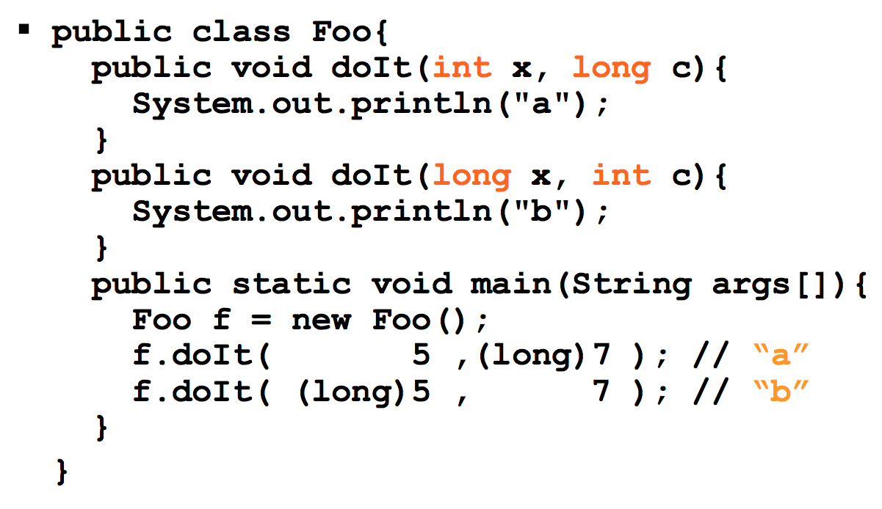
Method Overloading

Slide 51
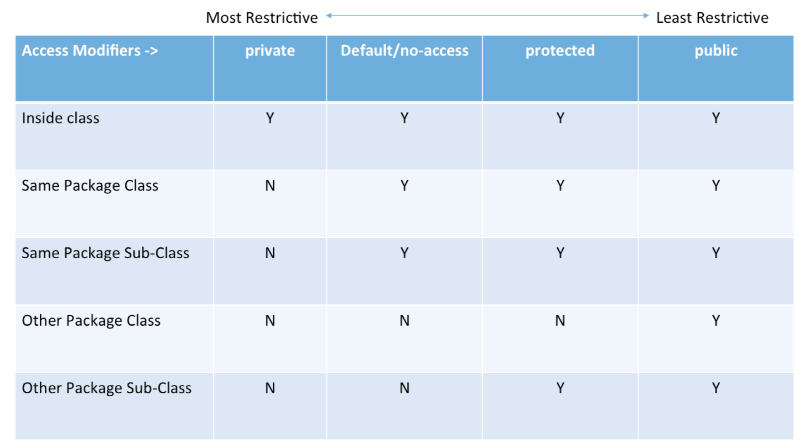
Visibility

Slide 52
Objects
􏰀An object is identified by:
Its class, which defines its structure in terms of attributes and methods
Its state (attributes values)
An internal unique identifier
try: System.out.println(new int[16]);
􏰀Zero, one or more reference can point to the same object

Slide 53
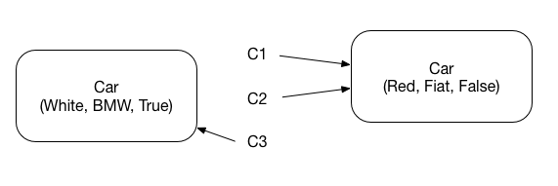
Objects creation
􏰀Creation of an object is made with the keyword new
􏰀It returns a reference to the piece of memory containing the created object
Car c1 = new Car(Red, Fiat, False);
Car c2 = c1;
Car c3 = new Car(White, BMW, True)

Slide 54
The keyword new
􏰀Creates a new instance of the specific Class, and allocates the necessary memory in the heap
􏰀Calls the constructor method of the object (a method without return type and with the same name of the Class)
􏰀Returns a reference to the new object created
􏰀Constructors can have parameters
String s = new String();
String s = new String(“ABC”);

Slide 55
Constructors
􏰀Constructor method contains operations we want to execute on each object as soon as it is created (make sure attributes are always initialized!)
􏰀Overloading of constructors is often used
􏰀If a Constructor is not declared, a default one (with no parameters) is defined. If a constructor with parameters is defined, the default one is disabled!

Slide 56
Constructors
public class Car {
private String color;
public void setColor(String c) { color = c; }
/* this is a constructor */
public Car(String c) {
color = c;
}
public static void main(String[] args) {
Car c = new Car(“red”);
}
}

Slide 57
The keyword this
􏰀It can be useful in methods to distinguish object attributes from local variables (this represents a reference to the current object)
class Car{
String color;
...
void paint (String color) {
this.color = color;
}
}
Methods accessing attributes or methods of the same object do not need using object reference (this implied)

Slide 58
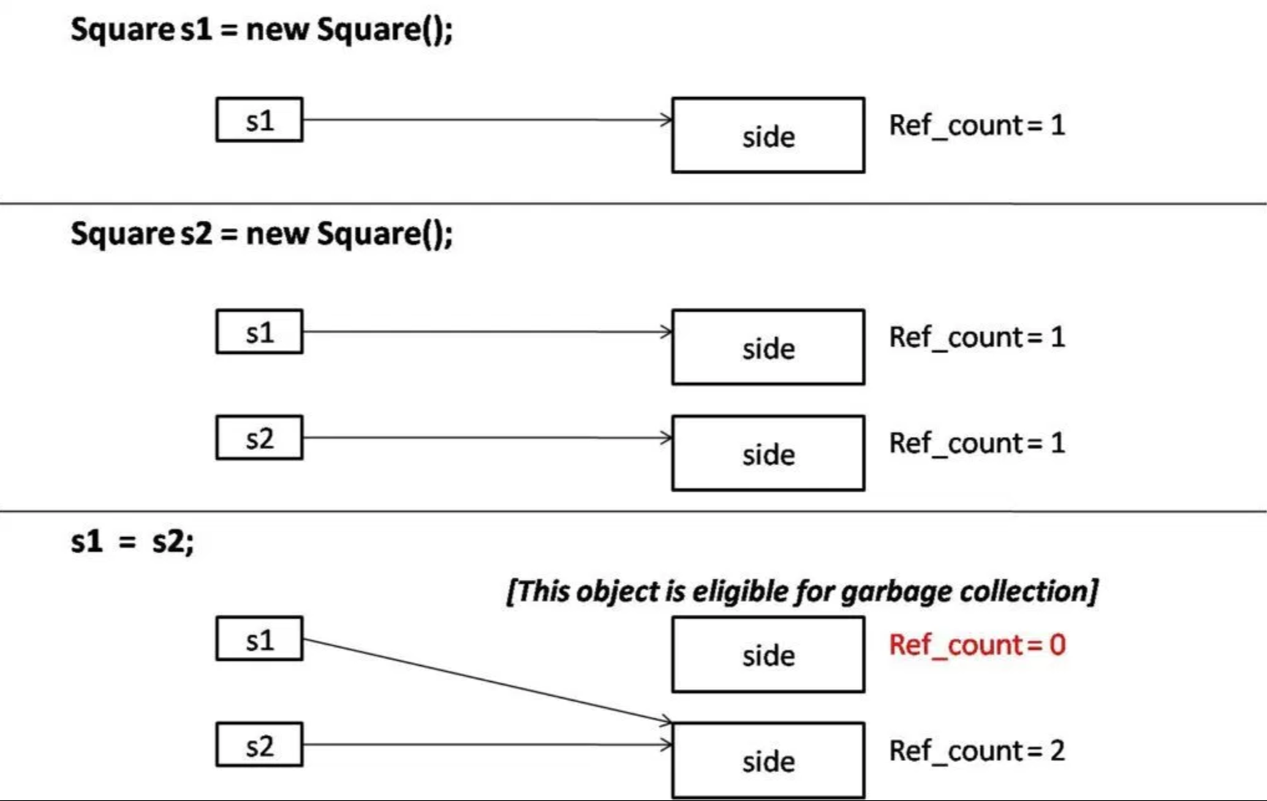
Objects Destruction
􏰀It is no longer a programmer concern, Java uses Garbage Collection (an automatic way for de-allocating unreferenced objects)

Slide 59
Combining dotted notations
􏰀Dotted notations can be combined
System.out.println(“Hello world!”);
System is a Class in package java.lang
Out is a (static) attribute of System referencing an object of type PrintStream (representing the standard output)
Println() is a method of PrintStream which prints a text line on the screen

Slide 60
Operations on references
Only the relational operators == and != are defined
Note well: the equality condition is evaluated on the values of the references and NOT on the values of the objects !
The relational operators tell you whether the references points to the same object in memory
􏰀Dotted notation is applicable to object references
􏰀There is NO pointer arithmetic

Slide 61
Package

Slide 62
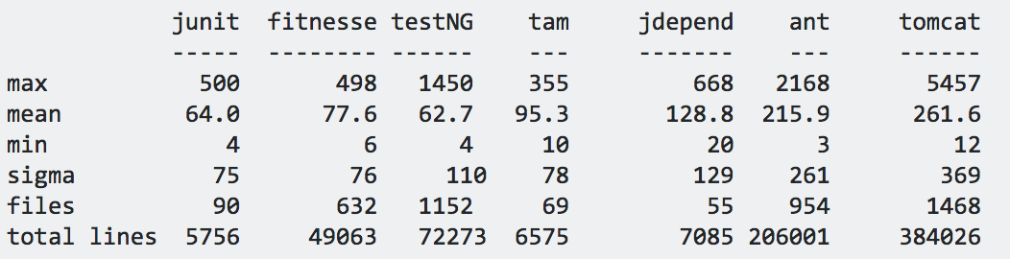
Motivation
􏰀Class is a better element of modularization than a procedure. But it is still little (100-200 lines on average)
􏰀For the sake of modularization, Java provides packages

Slide 63
Package
􏰀A package is a logic set of class definitions
􏰀These classes are all stored in the same directory
􏰀Each package defines a new scope (i.e., it puts additional bounds to visibility)
􏰀It’s then possible to use same class names in different packages without name conflicts

Slide 64
Package names
􏰀A package is identified by a name with a hierarchic structure (fully qualified name)
java.lang.String
java.util.Date
java.sql.Date
􏰀Conventions to create unique names (Internet name in reverse order)
it.unimo.myPackage

Slide 65
Package example
􏰀javax.swing
JWindow
JButton
JMenu
􏰀javax.swing.event (sub-package)
JComponent
JInternalFrame

Slide 66
Definition and usage
􏰀Definition: Package statement at the beginning of class file
package packageName;
􏰀Usage: Import statement at the beginning of class file
import packageName.className;
import java.awt.*;

Slide 67
Access to a class in a package
􏰀Referring to a method/class of a package
int i = myPackage.Console.readInt()
􏰀If two packages define a class with the same name, they cannot be both imported. If you need both classes you have to use one of them with its fully-qualified name:
import java.sql.Date; Date d1; // java.sql.Date java.util.Date d2 = new java.util.Date();

Slide 68
Package and scope
􏰀Scope rules also apply to packages
􏰀The interface of a package is the set of public classes contained in the package
􏰀Hints
Consider a package as an entity of modularization
Minimize the number of classes, attributes, methods visible outside the package

Slide 69
Visibility w/ multiple packages
public class A { }
Public methods/attributes of A are visible outside the package
􏰀class B { }
No method/attribute of B is visible outside the package

Slide 70
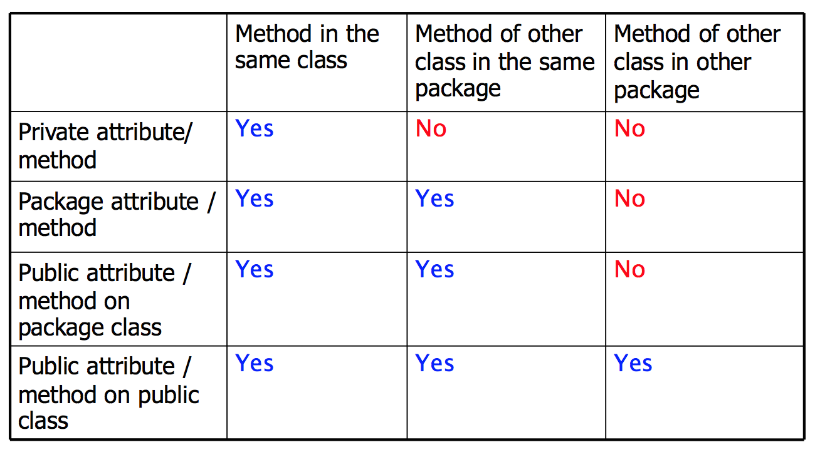
Access Rules

Slide 71
Static attributes and methods

Slide 72
Static attributes and methods
􏰀Represent properties (attributes) and behaviors (methods) which are common to all instances of an object
􏰀They exist even when no object has been instantiated!
􏰀They are defined with the static modifier
􏰀Access: ClassName.attributename|methodname

Slide 73
Static attributes and methods
Class Car {
static final int nWheels = 4;
/* … */
}
public static void main(String[] args) {
/* access to a static attribute */
int n = Car.nWheels;
…
/* access to a static method */
Double cos = Math.cos();
}

Slide 74
Wrapper Classes

Slide 75
Wrapper Classes
In an ideal OO world, there are only classes and objects
For the sake of efficiency, Java use primitive types (int, float, etc.)
Wrapper classes are object versions of the primitive types
They provide conversion operations among Strings, Objects, and primitive types

Slide 76
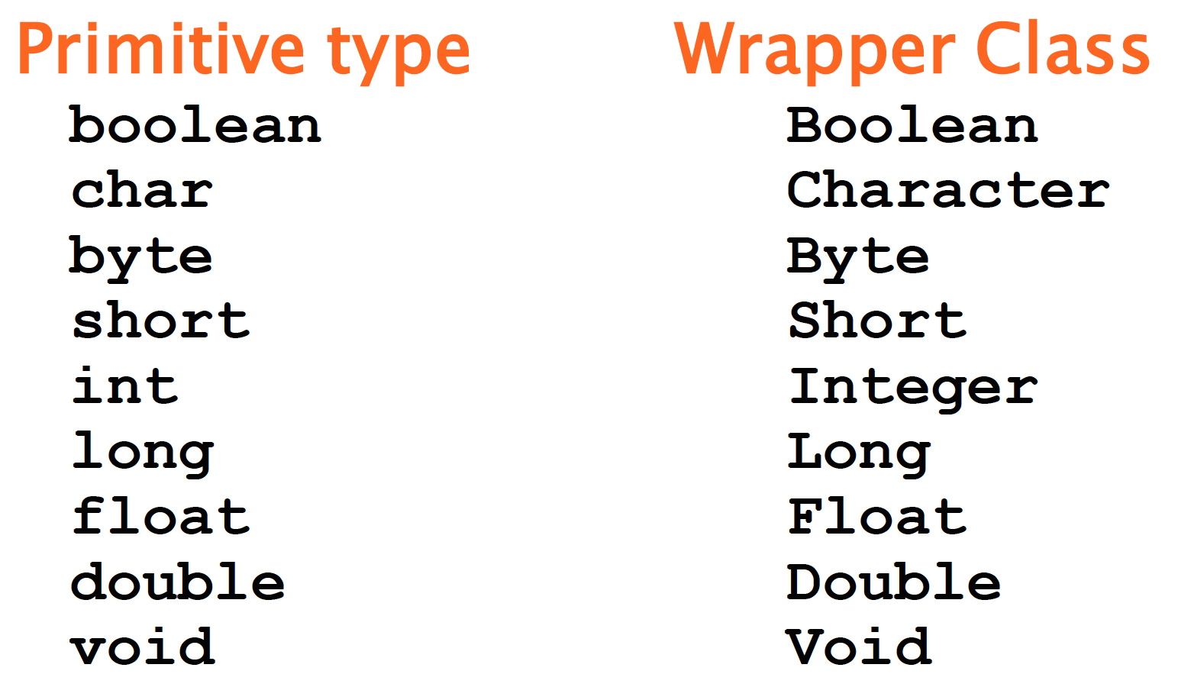
Wrapper Classes

Slide 77
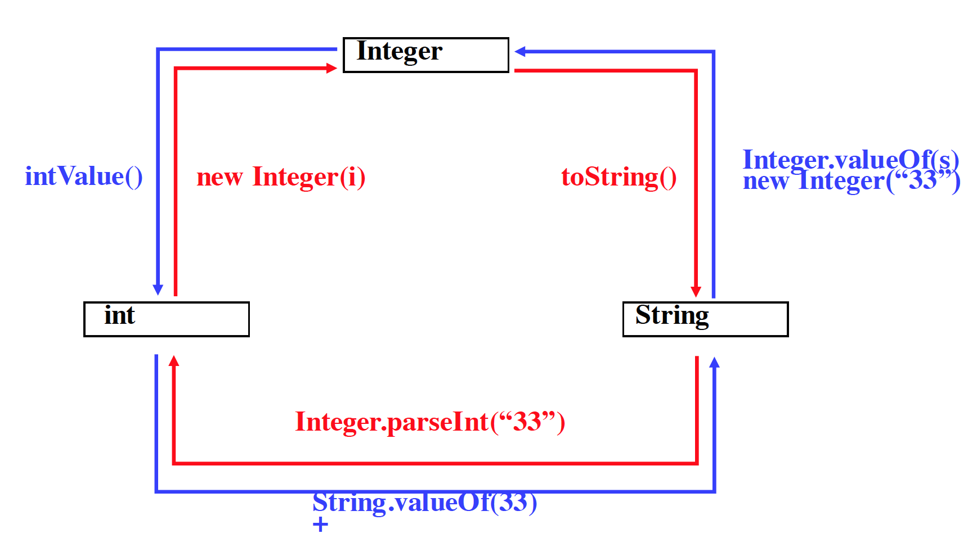
Conversions

Slide 78
Conversions, examples
Integer obj = new Integer(88);
String s = obj.toString();
int i = obj.intValue();
Int i = Integer.parseInt(“99”);
int k = (new Integer(99)).intValue();

Slide 79
Autoboxing
Auto boxing is the automatic conversion that the Java compiler makes between the primitive types and their corresponding object wrapper classes. For example, converting an int to an Integer, a double to a Double, and so on. If the conversion goes the other way, this is called Unboxing.
class AutoboxingExample {
public static void myMethod(Integer num){
System.out.println(num);
}
public static void main(String[] args) {
/* passed int (primitive type), it would be
* converted to Integer object at Runtime
*/
myMethod(2);
}
}

Slide 80
Unboxing
Auto boxing is the automatic conversion that the Java compiler makes between the primitive types and their corresponding object wrapper classes. For example, converting an int to an Integer, a double to a Double, and so on. If the conversion goes the other way, this is called Unboxing.
class UnboxingExample {
public static void myMethod(int num){
System.out.println(num);
}
public static void main(String[] args) {
Integer inum = new Integer(100);
/* passed Integer wrapper class object, it
* would be converted to int primitive type
* at Runtime */
myMethod(inum);
}
}

